Slide 1
Welcome to the 2020-2021 school year.
Things will be different as we are 100% virtual.
Four things will always be on these slides:
1) A bell ringer
Something to do as you arrive
2) A title slide
Record it and the date in your notebook
3) “Today’s Agenda”
What will be happening in class
4) “The future”
Homework / plans

Slide 2
Welcome
Mr. Short
Public Speaking
14 or 15 September 2020

Slide 3
Today’s
Syllabus Review
This Year’s Speeches
Policies and Procedures

Slide 4
Syllabus Review:
Overview
Goals & Objectives
Materials
Antiperspirant / Deodorant
Class Policies
Tardy Passes
Grading
Rubrics
Late Work
Absences
Academic Integrity
Signatures

Slide 5
"Off and Away until the End of the Day"
Is it a cell phone?
"Off and Away until the End of the Day“
Is it an Apple product?
"Off and Away until the End of the Day“
Is it a music/gaming device?
"Off and Away until the End of the Day“
Is it anything electronic not necessary to continue life functions?
"Off and Away until the End of the Day"

Slide 6
Cell Phones for Academic Use:
This year, you will video record a few of your presentations with your phone.
These videos are for your personal use to help improve presentations.
Your first recorded presentation will be Monday or Tuesday next week.
You will be introducing yourself to the class.
Be sure to have your phone or other video recording device.

Slide 7
“Stage Fright”
This quarter is designed to help you feel comfortable presenting to the class.
Our first presentation will be next week.
Introduce yourself to the class on video chat.
The presentation after this, you will be able to turn your camera off.

Slide 8
What We Will Learn:
How to become a better public speaker.
This is done through:
Confidence
Physical Presence
Volume & Tone
Diction & Voice
Organization & Structure
Interaction

Slide 9
This Year’s Speeches:
We will cover the following areas:
Informative
Persuasive
Entertaining
Visual Aid (Show & Tell)
Demonstration (How To)
Movie Review
Story Telling
Computer Aided Presentations
Extemporaneous (“With little preparation”)

Slide 10
Frankfort-Schuyler Culture:
The following three slides are from OHM B.O.C.E.S, describing teacher beliefs and classroom behaviors in our area.
2015-2016

Slide 11
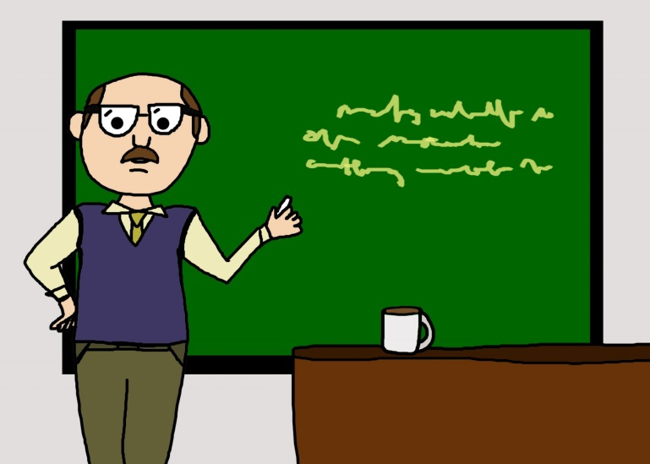
Instructional Rounds & Culture:
Above all, the majority of teachers believe that if they are not talking, then they are not teaching.

Slide 12
Our Region’s Culture
The majority of teachers believe that our students need their hands held; that they “can’t” because they are poor.
Thus, the majority of our teachers believe that our students “need” them much more than they actually do.

Slide 13
TEACHER RESPONSIBILITY
“I do it”
Focus Lesson
Guided Instruction
“We do it”
Collaborative
“You do it
together”
Independent
“You do it
alone”
STUDENT RESPONSIBILITY
Fisher and Frey

Slide 14
Locations Around The Room:
Sign-Out Sheet
Office/Guidance/Nurse
Restroom/drink at other times please.
Tardy Passes
Stapler
Hole Puncher
Garbage & Recycling
Other?

Slide 15
Mr. Short’s Student of the Month
Criteria:
Hard Work
Focus
Participation
Respect
Two students from Public Speaking, two from English 12.

Slide 16
Name Tags:
Tell about yourself with your name.
On a sheet of paper write your name in large font and decorate your name tag to show who you are.
Pictures, magazine cut outs, drawings to show your hobbies, interests, & life.
People should be able to learn about you by looking at your nametag.
We will need name tags for the next two weeks.

Slide 17
Homework:
Signatures
Get Public Speaking materials:
Binder, notebook, note cards, antiperspirant/deodorant
Next Class
Decorated name tag due:
Days 1 & 3: Monday, the 21st
Days 2 & 4: Tuesday, the 22nd
Nervous?
It’s okay, it will get better.

